Slide 1



NEXT

Slide 2



Hi! My name is Adam and
I am a museum explorer.
My family loves visiting museums
and I want to share with you what
I have learnt.
BACK
NEXT

Slide 3

BACK
NEXT

Slide 4


I will be visiting the
Malay Heritage Centre today
to learn something new.
Are you ready?
Come, join me on my adventure!
BACK
NEXT

Slide 5
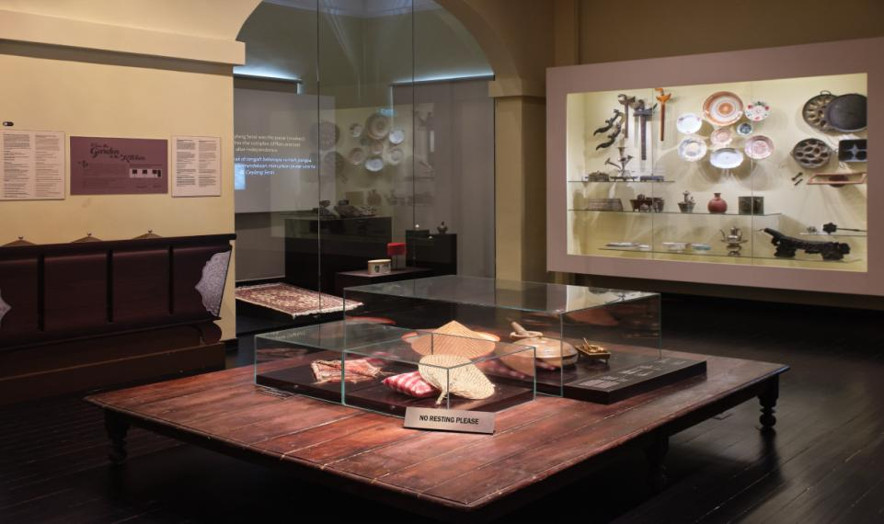

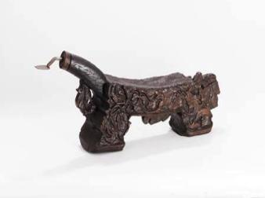



Have you seen this object before? Can you make a guess what this is?
Carved Wooden Coconut Grater | Malay Heritage Centre Collection

Slide 6



Let me give you a little clue.
BACK
NEXT

Slide 7
Carved Wooden Coconut Grater | Malay Heritage Centre Collection
It is a COCONUT GRATER.
BACK
NEXT

Slide 8

Carved Wooden Coconut Grater | Malay Heritage Centre Collection
Can you repeat after me?
COCONUT GRATER
BACK
NEXT

Slide 9
The coconut grater is also known as
KUKUR KELAPA in Malay.
Carved Wooden Coconut Grater | Malay Heritage Centre Collection
BACK
NEXT

Slide 10
KELAPA
means coconut in Malay.
BACK
NEXT

Slide 11

But how do you grate the
coconut using this?
Carved Wooden Coconut Grater | Malay Heritage Centre Collection
BACK
NEXT

Slide 12
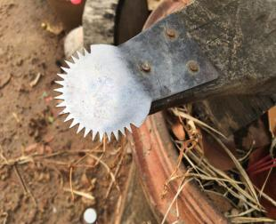
Carved Wooden Coconut Grater | Malay Heritage Centre Collection
You will need to sit on the
low stool and grate the coconut with the blade in front.
BACK
NEXT

Slide 13

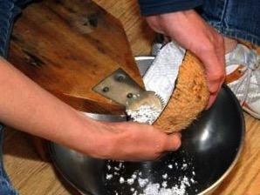
You need to hold half a coconut shell and
grate the white flesh against the blade
in an up and down motion.
BACK
NEXT

Slide 14

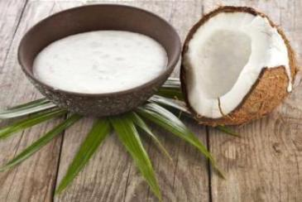

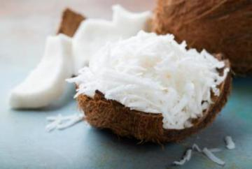
Water is then added to help squeeze out the milk,
or you can use the grated flesh as it is.
Coconut Milk
Grated Coconut Flesh
BACK
NEXT

Slide 15

Coconut is a common ingredient
used in Malay cooking.
BACK
NEXT

Slide 16

Let’s find out more about the different uses of coconut in Malay food!
BACK
NEXT

Slide 17


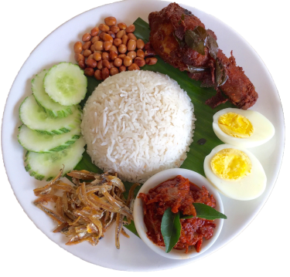

Nasi Lemak
Rice made fragrant with coconut milk and eaten with fried chicken, peanuts, eggs, fried ikan bilis (dried anchovies) and chilli.
BACK
NEXT

Slide 18

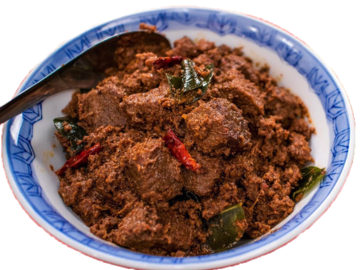
Rendang
A meat dish that is slow cooked in coconut milk and spices.
BACK
NEXT

Slide 19

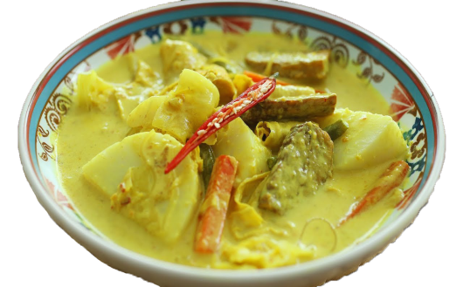
Lontong
Boiled rice cake in a fragrant coconut vegetable stew.
BACK
NEXT

Slide 20
Nasi Lemak, Rendang and
Lontong are some of the dishes
made with coconut milk.
BACK
NEXT

Slide 21

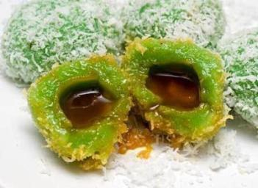
Ondeh Ondeh
Pandan flavoured rice ball filled with gula melaka (palm sugar) and covered in grated coconut.
BACK
NEXT

Slide 22

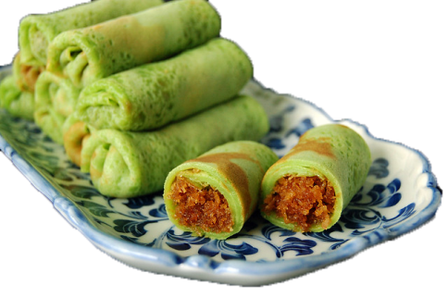
Kueh Dadar
Pandan crepe wrapped with grated coconut filling cooked in gula melaka (palm sugar).
BACK
NEXT

Slide 23

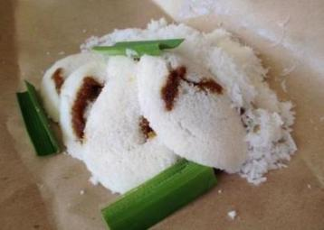
Putu Piring
Round, steamed rice cake filled with
melted gula melaka (palm sugar) and eaten with freshly grated coconut.
BACK
NEXT

Slide 24
Ondeh Ondeh, Kueh Dadar
and Putu Piring are some of the dishes made with coconut shavings.
BACK
NEXT

Slide 25

I hope you have enjoyed learning about delicious food made with coconut.
BACK
NEXT

Slide 26

Now, are you ready
for some games?
Click on the START button!
Start

Slide 27

Instructions:
Click on the correct food that is made using
coconut milk as an ingredient.
Start

Slide 28





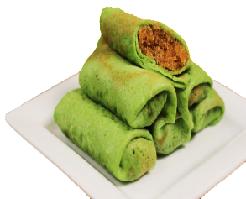





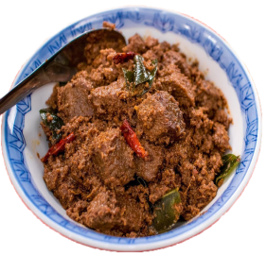
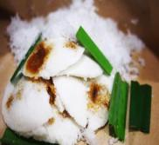
Click on the correct food that is made using
coconut milk as an ingredient.
Nasi Lemak
Kueh Dadar
Lontong
Ondeh Ondeh
Rendang
Putu Piring

Slide 29

Click on the correct food that is made using
coconut milk as an ingredient.
Nasi Lemak
Kueh Dadar
Lontong
Ondeh Ondeh
Rendang
Putu Piring

Slide 30
Click on the correct food that is made using
coconut milk as an ingredient.
Nasi Lemak
Kueh Dadar
Lontong
Ondeh Ondeh
Rendang
Putu Piring

Slide 31
Click on the correct food that is made using
coconut milk as an ingredient.
Nasi Lemak
Kueh Dadar
Lontong
Ondeh Ondeh
Rendang
Putu Piring

Slide 32
Click on the correct food that is made using
coconut milk as an ingredient.
Nasi Lemak
Kueh Dadar
Lontong
Ondeh Ondeh
Rendang
Putu Piring

Slide 33
Click on the correct food that is made using
coconut milk as an ingredient.
Nasi Lemak
Kueh Dadar
Lontong
Ondeh Ondeh
Rendang
Putu Piring

Slide 34
Click on the correct food that is made using
coconut milk as an ingredient.
Nasi Lemak
Kueh Dadar
Lontong
Ondeh Ondeh
Rendang
Putu Piring

Slide 35






CORRECT
Nasi Lemak
Rendang
Lontong
Next
Notes:
Change the next button

Slide 36

Try Again

Slide 37

Try Again

Slide 38
Try Again

Slide 39
Try Again

Slide 40
Try Again

Slide 41
Try Again

Slide 42
Try Again

Slide 43
Try Again

Slide 44
Try Again

Slide 45
Try Again

Slide 46
Try Again

Slide 47
Try Again

Slide 48
Try Again

Slide 49
Try Again

Slide 50
Try Again

Slide 51
Try Again

Slide 52
Try Again

Slide 53
Try Again

Slide 54
Try Again

Slide 55
Try Again

Slide 56
Try Again

Slide 57

Instructions:
Click on the correct food that is made using
coconut shavings as an ingredient.
Start

Slide 58

Click on the correct food that is made using
coconut shavings as an ingredient.
Ondeh Ondeh
Rendang
Lontong
Nasi Lemak
Kueh Dadar
Putu Piring

Slide 59
Click on the correct food that is made using
coconut shavings as an ingredient.
Ondeh Ondeh
Rendang
Lontong
Nasi Lemak
Kueh Dadar
Putu Piring

Slide 60
Click on the correct food that is made using
coconut shavings as an ingredient.
Ondeh Ondeh
Rendang
Lontong
Nasi Lemak
Kueh Dadar
Putu Piring

Slide 61
Click on the correct food that is made using
coconut shavings as an ingredient.
Ondeh Ondeh
Rendang
Lontong
Nasi Lemak
Kueh Dadar
Putu Piring

Slide 62
Click on the correct food that is made using
coconut shavings as an ingredient.
Ondeh Ondeh
Rendang
Lontong
Nasi Lemak
Kueh Dadar
Putu Piring

Slide 63
Click on the correct food that is made using
coconut shavings as an ingredient.
Ondeh Ondeh
Rendang
Lontong
Nasi Lemak
Kueh Dadar
Putu Piring

Slide 64
Click on the correct food that is made using
coconut shavings as an ingredient.
Ondeh Ondeh
Rendang
Lontong
Nasi Lemak
Kueh Dadar
Putu Piring

Slide 65


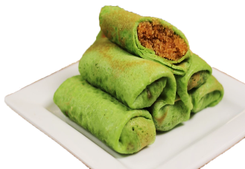

CORRECT
Ondeh Ondeh
Kueh Dadar
Putu Piring
Next

Slide 66
Try Again

Slide 67
Try Again

Slide 68
Try Again

Slide 69
Try Again

Slide 70
Try Again

Slide 71
Try Again

Slide 72
Try Again

Slide 73
Try Again

Slide 74
Try Again

Slide 75
Try Again

Slide 76
Try Again

Slide 77
Try Again

Slide 78
Try Again

Slide 79
Try Again

Slide 80
Try Again

Slide 81
Try Again

Slide 82
Try Again

Slide 83
Try Again

Slide 84
Try Again

Slide 85
Try Again

Slide 86
Try Again

Slide 87

Instructions:
Count and click on the correct number for each food item.
Start

Slide 88
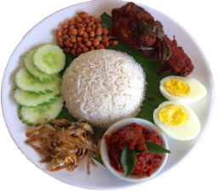
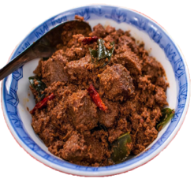


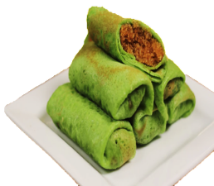
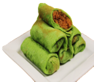


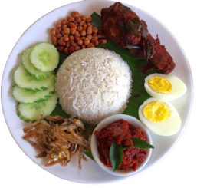



How many plates of Nasi Lemak do you see?

Slide 89




How many Ondeh Ondeh do you see?

Slide 90
CORRECT
There are 3 plates of Nasi Lemak.
Next
Notes:
Change vo

Slide 91
Try Again

Slide 92
Try Again

Slide 93
CORRECT
There are 10 pieces of Ondeh Ondeh.
Next

Slide 94
Try Again

Slide 95
Try Again

Slide 96
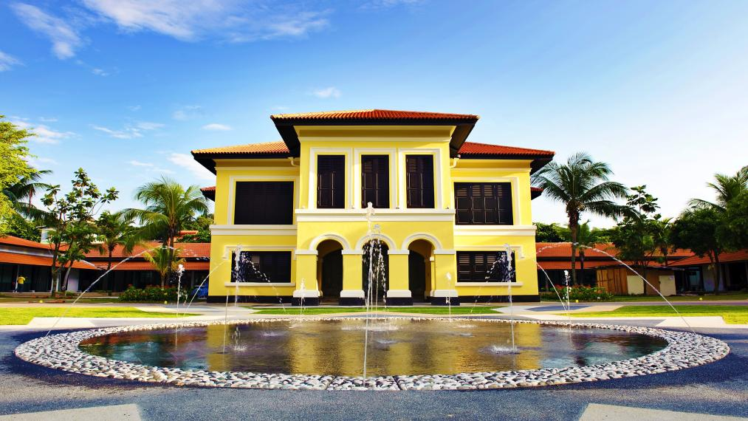

Thank you for joining me at the
Malay Heritage Centre!
I have learned so much and
I hope that you have enjoyed yourself.
Let’s recap what we have learnt!
BACK
NEXT

Slide 97

COCONUT GRATER
Carved Wooden Coconut Grater | Malay Heritage Centre Collection
BACK
NEXT

Slide 98

Different foods that use coconut.
BACK
NEXT

Slide 99

I hope that you can visit the
Malay Heritage Centre to learn more about the rich heritage and culture of the Singapore Malay community.
Join me at my next exciting adventure at the
Sun Yat Sen Nanyang Memorial Hall.
See you soon!
BACK
NEXT

Slide 100
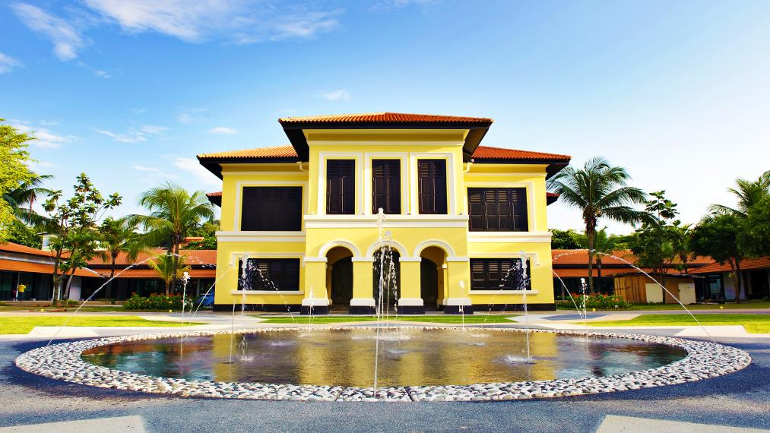

Did you know rendang and lontong are commonly served during Hari Raya Puasa?
Scan the QR code to find out more!
Visit malayheritage.org.sg to learn more about the Malay Heritage Centre!
BACK
NEXT

Slide 101


Brought to you by
Play Again
This resource is designed in conjunction with the Singapore’s Little Treasures programme and has been adopted for home or classroom- based learning. Copyrighted by the National Heritage Board. No part of this design may be reproduced, stored in a retrieval system, or transmitted in any form or by any means, electronic, mechanical, photocopying, recording or otherwise for profit without permission of the copyright owner.

